Slide 1

Social Influencer Platform
Firebase Database Design Draft V1.0

Slide 2
Firebase Database
Database Name: https://socialinfluencer-10d72.firebaseio.com/
Database Restriction under spark plan
Simultaneous connections : 100
GB stored : 1 GB
GB downloaded : 10 GB/month
Multiple databases per project: Not available under spark plan.

Slide 3
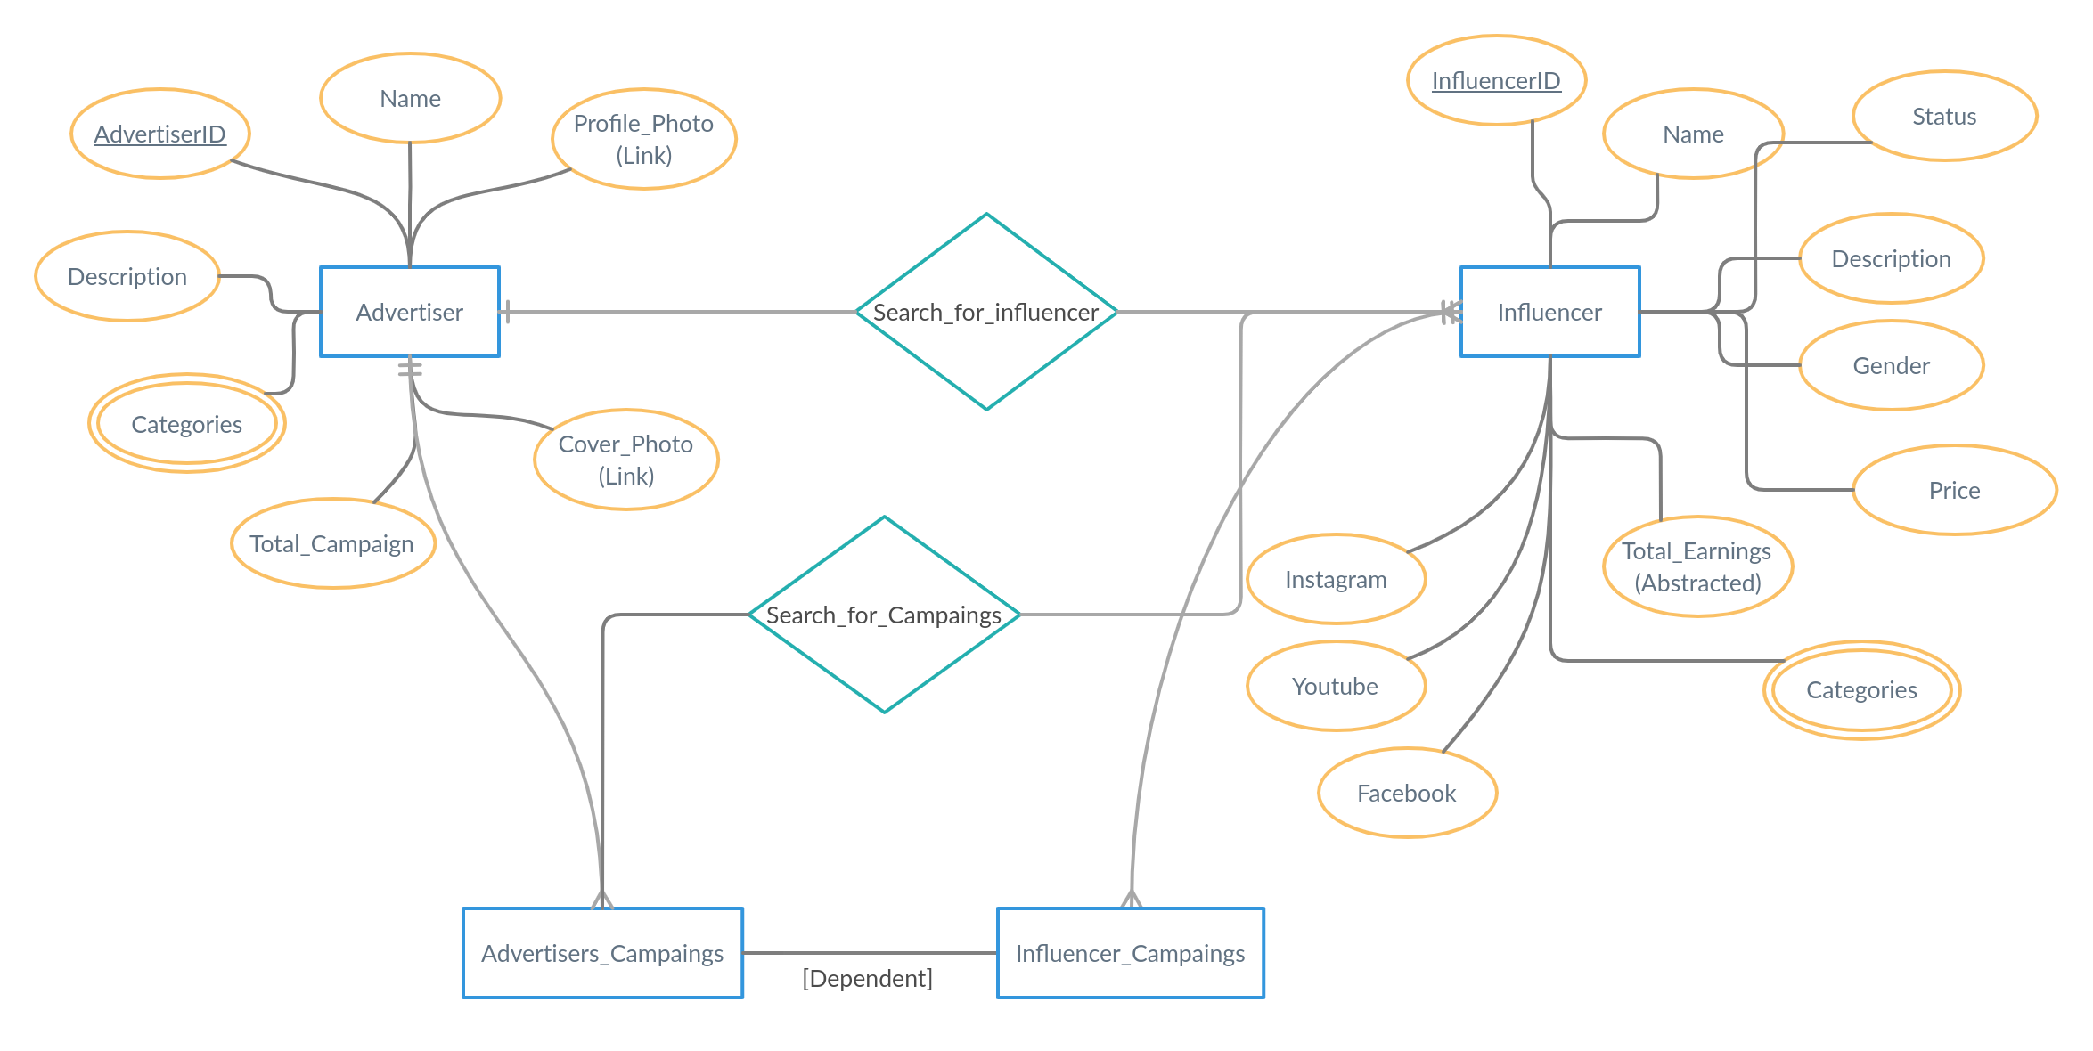
Social Influencer Data Design V 1.0
Below diagram shows ER Diagram of the database

Slide 4
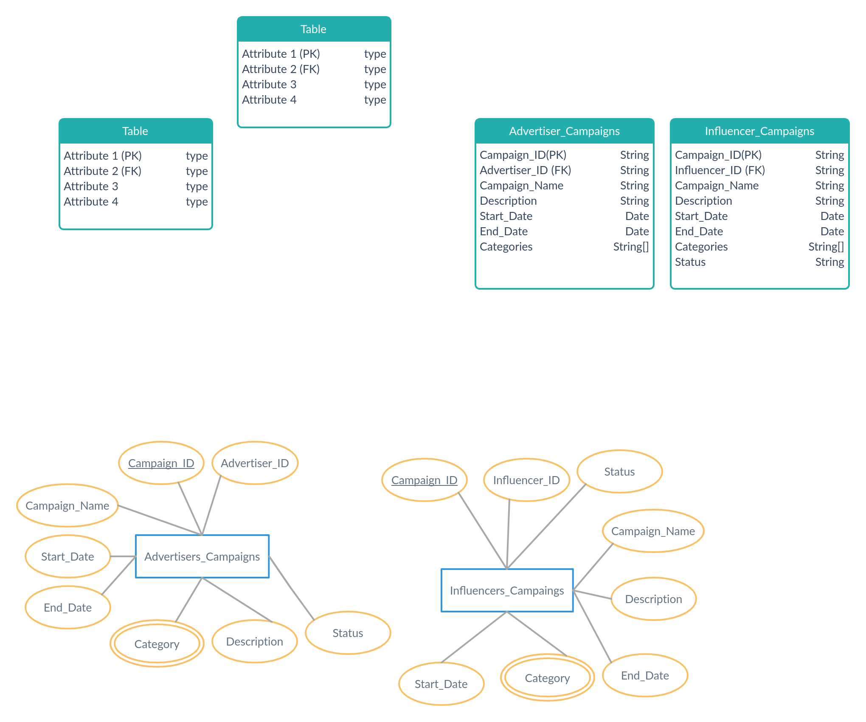
Social Influencer Data Design V 1.0
Below diagram shows ER Diagram of the 2 Entities

Slide 5
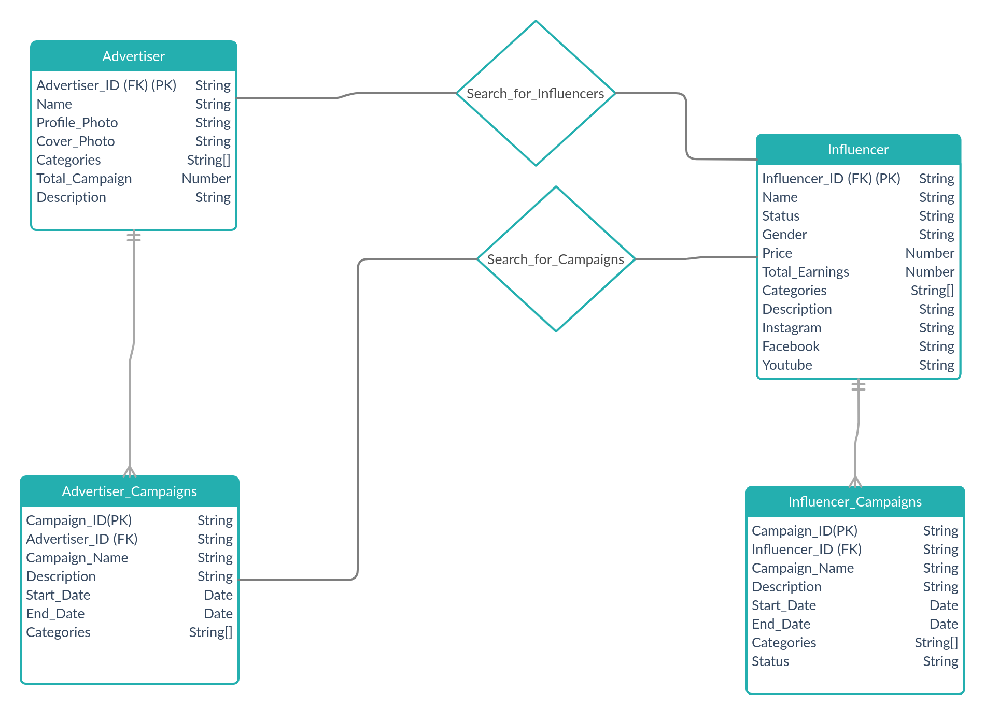
Table Structure
Below diagram shows the structure of the tables

Slide 6
Database structure
Database (https://socialinfluencer-10d72.firebaseio.com/ )
Influencers
Advertisers
Advertiser_Campaigns
Influencer_Campaigns

Slide 7
Store the table data in the form JSON
The Data in the table structure has relationship to exhibit that relationship we can use the Denormalization technique.
Specifying the data of the relation on the top level.
Influencer Campaigns
Campaign 1:
Field 1:
Field 2:
Campaign 2:
Influencer
Campaign 1: Ture
The Data in the table structure has relationship to exhibit that relationship we can use the nested schema (Antipattern)
Nested schema is like having a schema inside a schema.
Influencer and Campaigns
Influencer:
Campaigns:
Campaign 1:
Field 1
Field 2:
Campaign 2:

